Slide 1
Find and Catch
Yao-Tung Tsou

Slide 2
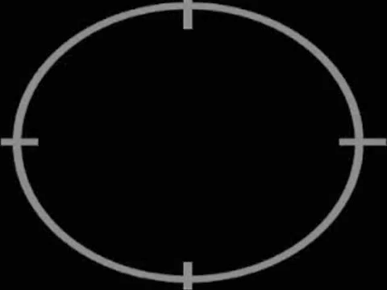

Slide 3
Mission
We will do a motion detector that can detect a human and trigger video recording.
Notes:
https://www.raspberrypi.org/learning/parent-detector/worksheet/

Slide 4
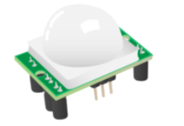
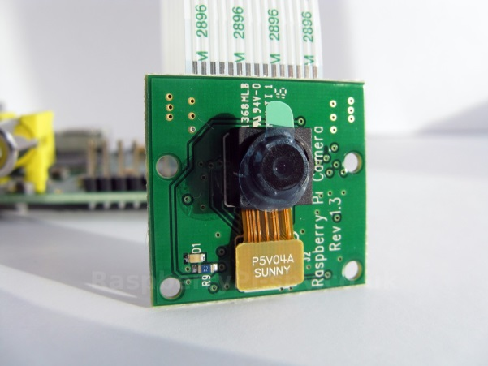
Modules
Passive Infrared (PIR) Motion Sensor
Camera

Slide 5
What is a PIR Sensor?
PIR sensor detects a human being moving around within approximately 10m from the sensor.
This is an average value, as the actual detection range is between 5m and 12m.
PIR are fundamentally made of a pyro electric sensor, which can detect levels of infrared radiation.

Slide 6
Areas of Applications of PIR Sensors
All outdoor Lights
Lift Lobby
Multi Apartment Complexes
Common staircases
For Basement or Covered Parking Area
Shopping Malls
For garden lights

Slide 7
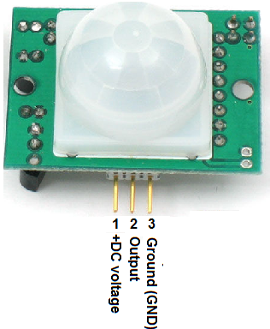
What is a PIR Sensor?
Most PIR sensors have a 3-pin connection at the side or bottom.
One pin is for +5 volts, one pin is for ground and the other is the sensor pin (the middle pin on our Pi).
The sensor pin will receive power whenever motion is detected by the PIR module.

Slide 8
What is a PIR Sensor?
Interfacing PIR with microcontroller is very easy and simple.
The PIR acts as a digital output so all you need to do is listening for the pin to flip high or low.
The motion can be detected by checking for a high signal on a single I/O pin.
Once the sensor warms up, the output will remain low until there is motion, at which time the output will swing high for a couple of seconds, then return low.
If motion continues, the output will cycle in this manner until the sensors line of sight of still again.

Slide 9
What is a PIR Sensor?
The PIR sensor needs a warm-up time with a specific end goal to capacity fittingly.
This is because of the settling time included in studying nature’s domain.
This could be anyplace from 10-60 seconds.

Slide 10
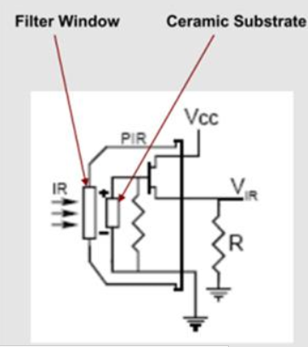
PIR Sensor IC
The PIR sensor IC consists of 3 pins-Vcc, Ground and Output.

Slide 11
PIR Sensor IC
ceramic substrate:
陶瓷基板
In presence of human IR radiations, the sensor detects the radiations and converts it directly to electrical pulses, which is fed to the inverter circuit.
The inverter circuit consists of a transistor, which gets into saturation with application of high base current and eventually develops a low collector voltage. Thus the transistor output is low.
This low inverter output is connected to the microcontroller.

Slide 12
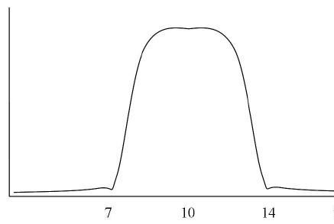
Filter Window (Optical Filter)
Human radiation: about 10um
Transmittance (%)
Wavelength (um)

Slide 13
Connecting PIR Sensor
Before booting your Raspberry Pi, connect the PIR module to the Raspberry Pi.
Using three female-to-female jumper cables, you'll need to connect each of the PIR sensor's connectors to the appropriate pins on the Raspberry Pi.

Slide 14
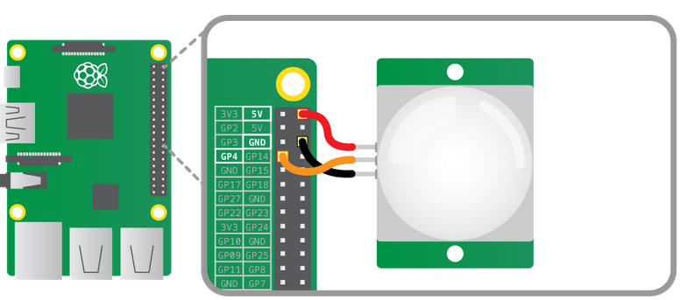
Connecting PIR Sensor
For example
VCC pin on the PIR sensor → 5V pin on the RPi
OUT pin → GPIO pin 4
GND pin → ground pin

Slide 15
Test the PIR sensor
We are going to write some code that will detect movement and print out some text.
Python is a candidate.
When movement is detected the PIR motion sensor applies power to its OUT pin, which we have connected to GPIO pin 4 on the Pi.
So in our code we just need to continually check pin 4 to see if it has power or not.
If a pin has power we call it HIGH and if not we call it LOW.

Slide 16
Test the PIR sensor
We will first set up the Raspberry Pi GPIO pins to allow us to use pin 4 as an input.
We need to check the pin continually for any changes, so we use a while True loop for this.
This is an infinite loop so the program will run continuously unless we stop it manually with Ctrl + C.
We then use two Boolean variables (True or False) for the previous and current states of the pin, the previous state being what the current state was the preceding time around the loop.
Inside the loop we compare the previous state to the current state to detect when they're different.
We don't want to keep displaying a message if there has been no change.

Slide 17
A Portion of the Code
import RPi.GPIO as GPIO
import time
sensor = 4
GPIO.setmode(GPIO.BCM)
GPIO.setup(sensor, GPIO.IN, GPIO.PUD_DOWN)
previous_state = False
current_state = False
while True:
….. #you need to append your program here
print("GPIO pin %s is %s" % (sensor, new_state))

Slide 18
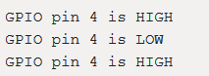
Results
If you start moving or waving the sensor pin will go HIGH.
Keep on waving and it will stay HIGH, and only go back to LOW if you keep still again.
If you see the sensor behave like this, then everything is working correctly.
If not, something is wrong and you need to go back and troubleshoot.

Slide 19
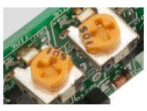
Notice
On the PIR module you should see two orange components with sockets that fit a Phillips screwdriver (see below).
These are called potentiometers: they allow you to adjust the sensitivity of the sensor and the detection time.
You should begin by setting the sensitivity to max and the time to min, but you can vary this later if you wish.

Slide 20
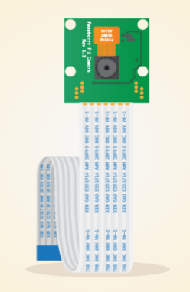
About Camera module
The Raspberry Pi camera module can be used to take high-definition video, as well as stills photographs.
It’s easy to use for beginners, but has plenty to offer advanced users if you’re looking to expand your knowledge.
There are lots of examples online of people using it for time-lapse, slow-motion and other video cleverness.
You can also use the libraries we bundle with the camera to create effects.

Slide 21
About Camera module
5 megapixel native resolution sensor-capable of 2592 x1944 pixel static images.
Supports 1080p30, 720p60 and 640x480p60/90 video
It attaches via a 15cm ribbon cable to the CSI port on the Raspberry Pi.
Camera is supported in the latest version of Raspbian, Raspberry Pi's preferred operating system
Notes:
1080p30: 1080p @ 30 fps
P: progressive scan
30: 30Hz

Slide 22
About Camera module
The camera module is very popular in home security applications, and in wildlife camera traps.

Slide 23
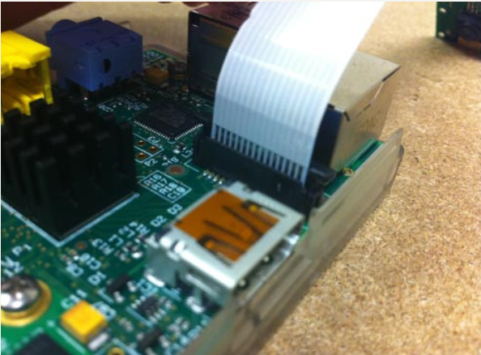
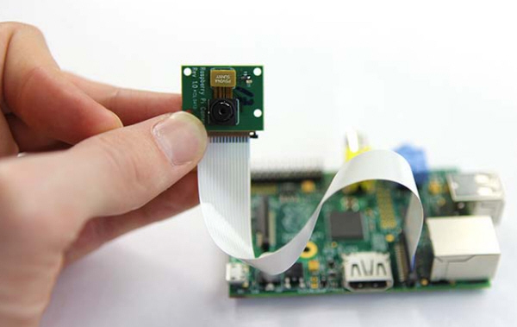
Connection
Before connecting, please power off the raspberry pi

Slide 24
Configure Camera
Enable camera
Run sudo raspi-config
Navigate to the “5. Enable Camera" option, and enable it.
Select “Enable” and reboot your Raspberry Pi.

Slide 25
How to Take a Picture
1. "raspistill" is a command line application that allows you to capture images with your camera module.
2. To capture an image in jpeg format, type "raspistill -o image.jpg" at the prompt, where "image" is the name of your image

Slide 26
Another solution: picamera
Using ‘picamera’ module
1. sudo apt-get install rpi-update
2. install ez-setup program
Wget https://bootstrap.pypa.io/ez_setup.py -O - | python
unzip setuptools-18.4.zip
cd setuptools-18.4
sudo python ./setup.py install
3. install pytest module
easy_install –U pytest
4. install python image module
sudo apt-get install python-imaging
5. install GPIO function
sudo apt-get install python-picamera python3picamera python-rpi.gpio
6. download picamera
Wget https://github.com/waveform80/picamera/arcgive/master.zip
unzip master.zip –d piccamera
7. Install piccamera
cd piccamera
sudo python ./setup.py install

Slide 27
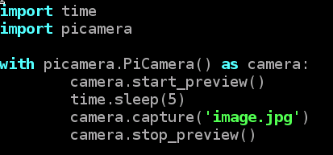
Sample code: image.py

Slide 28
How to Record a Video
1. "raspivid" is a command line application that allows you to capture video with your camera module.
2. To capture a 10 second video with your Raspberry Pi camera module
run "raspivid -o video.h264 -t 10000" at the prompt, where "video" is the name of your video and "10000" is the number of milliseconds
Notes: test the camera “raspivid –t 0”；press “ctrl+c” to exit

Slide 29
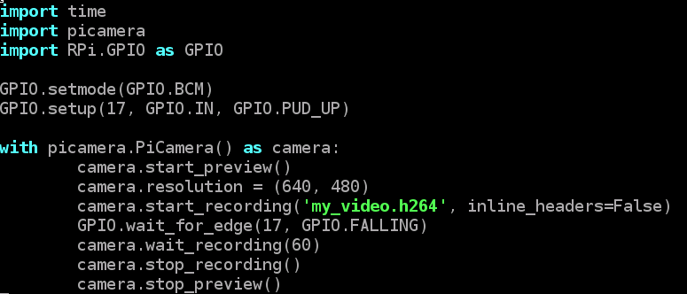
Another solution: picamera

Slide 30
Lab 4: trigger PIR sensor and tracking
Doing a motion detector that can detect human motion, and then triggering video record. (80 points)
Using OpenCV package to track the human. (90 points)

Slide 31
Advanced Practice
How to stream video/image from the Raspberry Pi camera over a network?
If you finish this lab, your scores of this lab will be 100 points.

Slide 32
End

